Slide 1


Automated
Account (BOT)
Identifier
Judith Cuellar, Juliet Messier,
Micheal McCloskey, Seren Frazin,
Stacie Sauer-Rackham

Slide 2


What Are Automated Accounts (Bots)?
Bots are autonomous software that can control Twitter accounts. They can be helpful or harmful

Slide 3
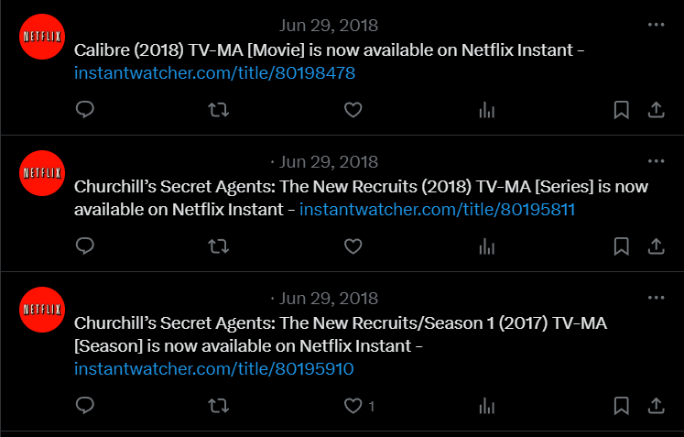
The Problem
Bots can be hard to identify. Malicious bots can disseminate misinformation, manipulate trends, and push malicious links.

Slide 4
Our Plan
1
Gather Data
Develop an Accurate Machine Learning Model
2
Determine which model identifies bots most accurately
3
4
Conduct Further Analysis
Create an interactive dashboard
5

Slide 5

Our
Data
Pulled thousands of tweets from the Twitter API and Bot Repository
Combined and cleaned our data into a singular dataset
Stored our data in a Postgre SQL Database

Slide 6

Choosing
a Model
We considered five models for identifying bots:
Random Forest
GBM
Tensor Flow
Logistic Regression
KNN

Slide 7
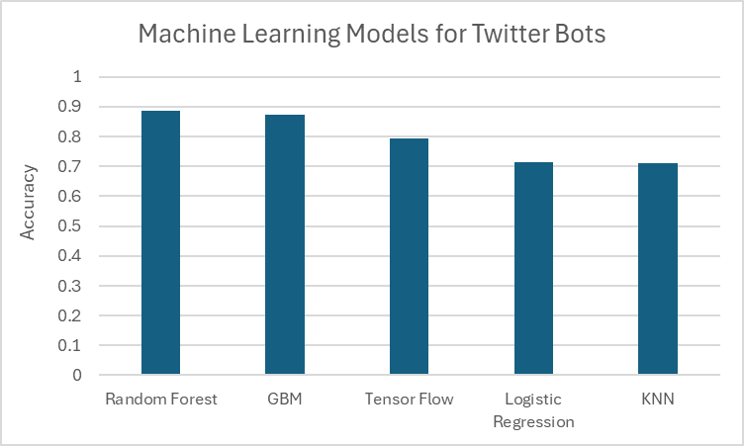
Performance

Slide 8

BEST PERFORMER
Random Forest Identified Bots
with 89%
Accuracy

Slide 9
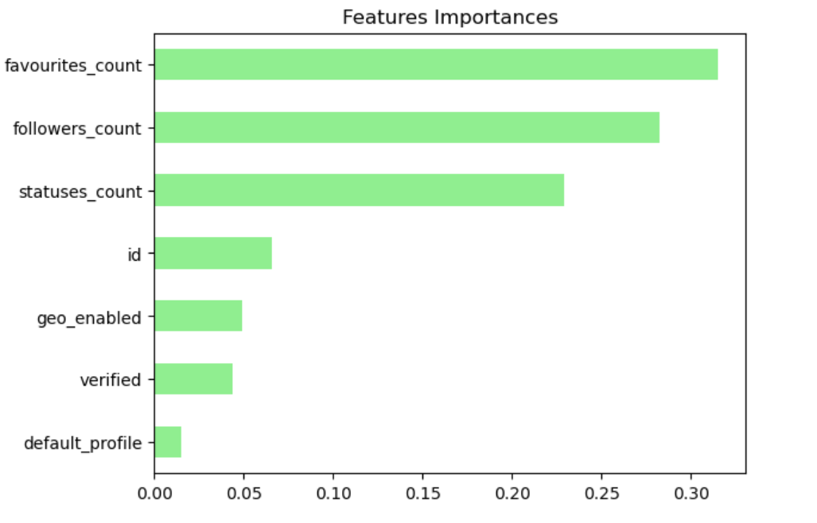
Most Important Factors

Slide 10

Further Analysis
To better understand the factors that influenced our Random Forest Model, we examined the relationship between bots and follower activity, geo location, and median followers

Slide 11
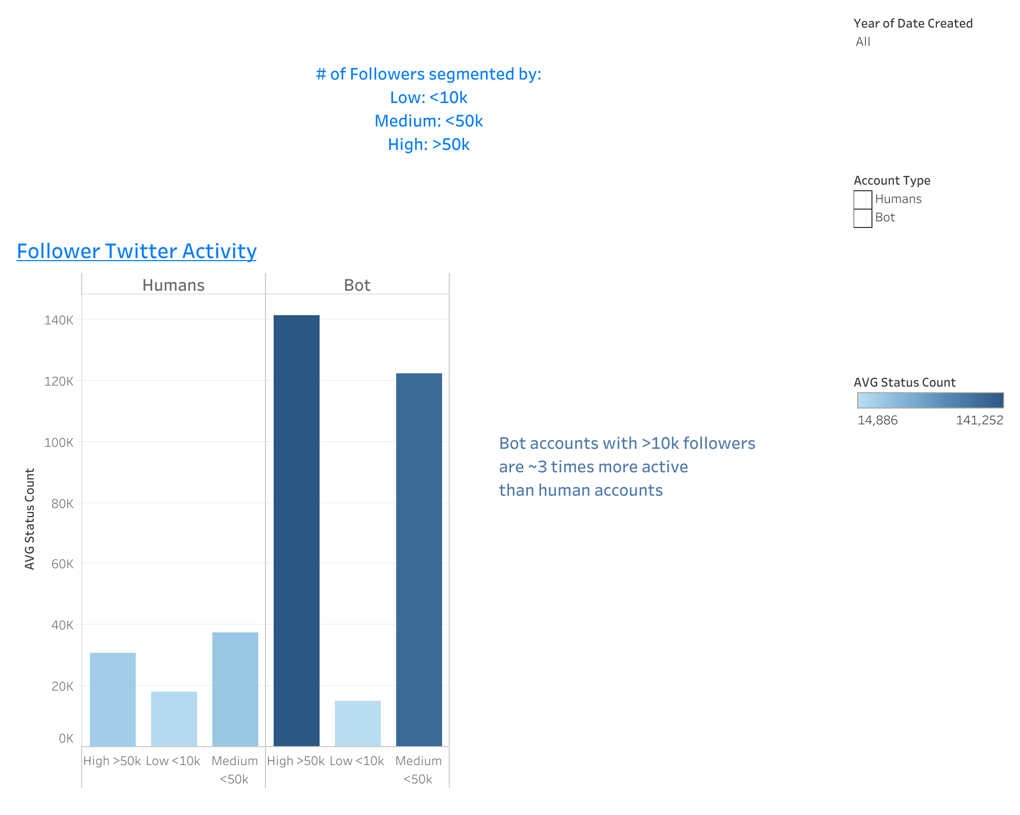
Follower Activity

Slide 12
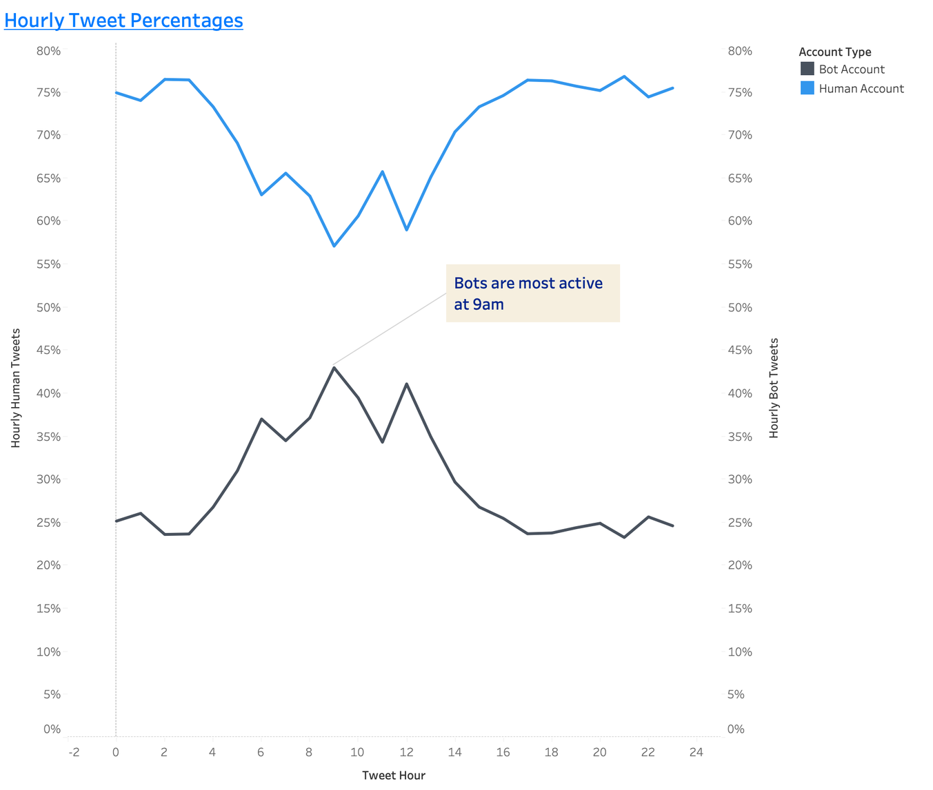
Follower Activity

Slide 13
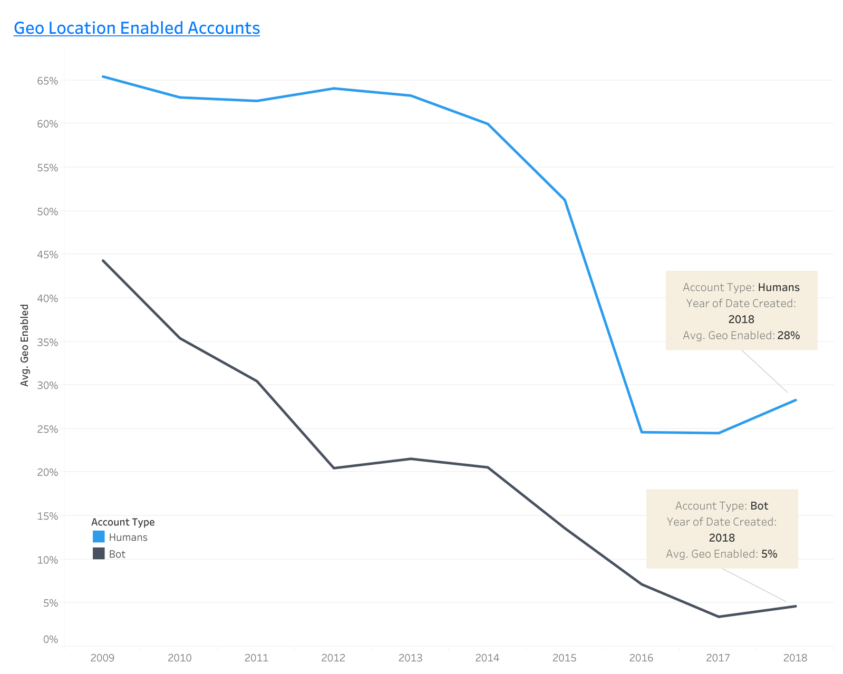
Geo Location

Slide 14
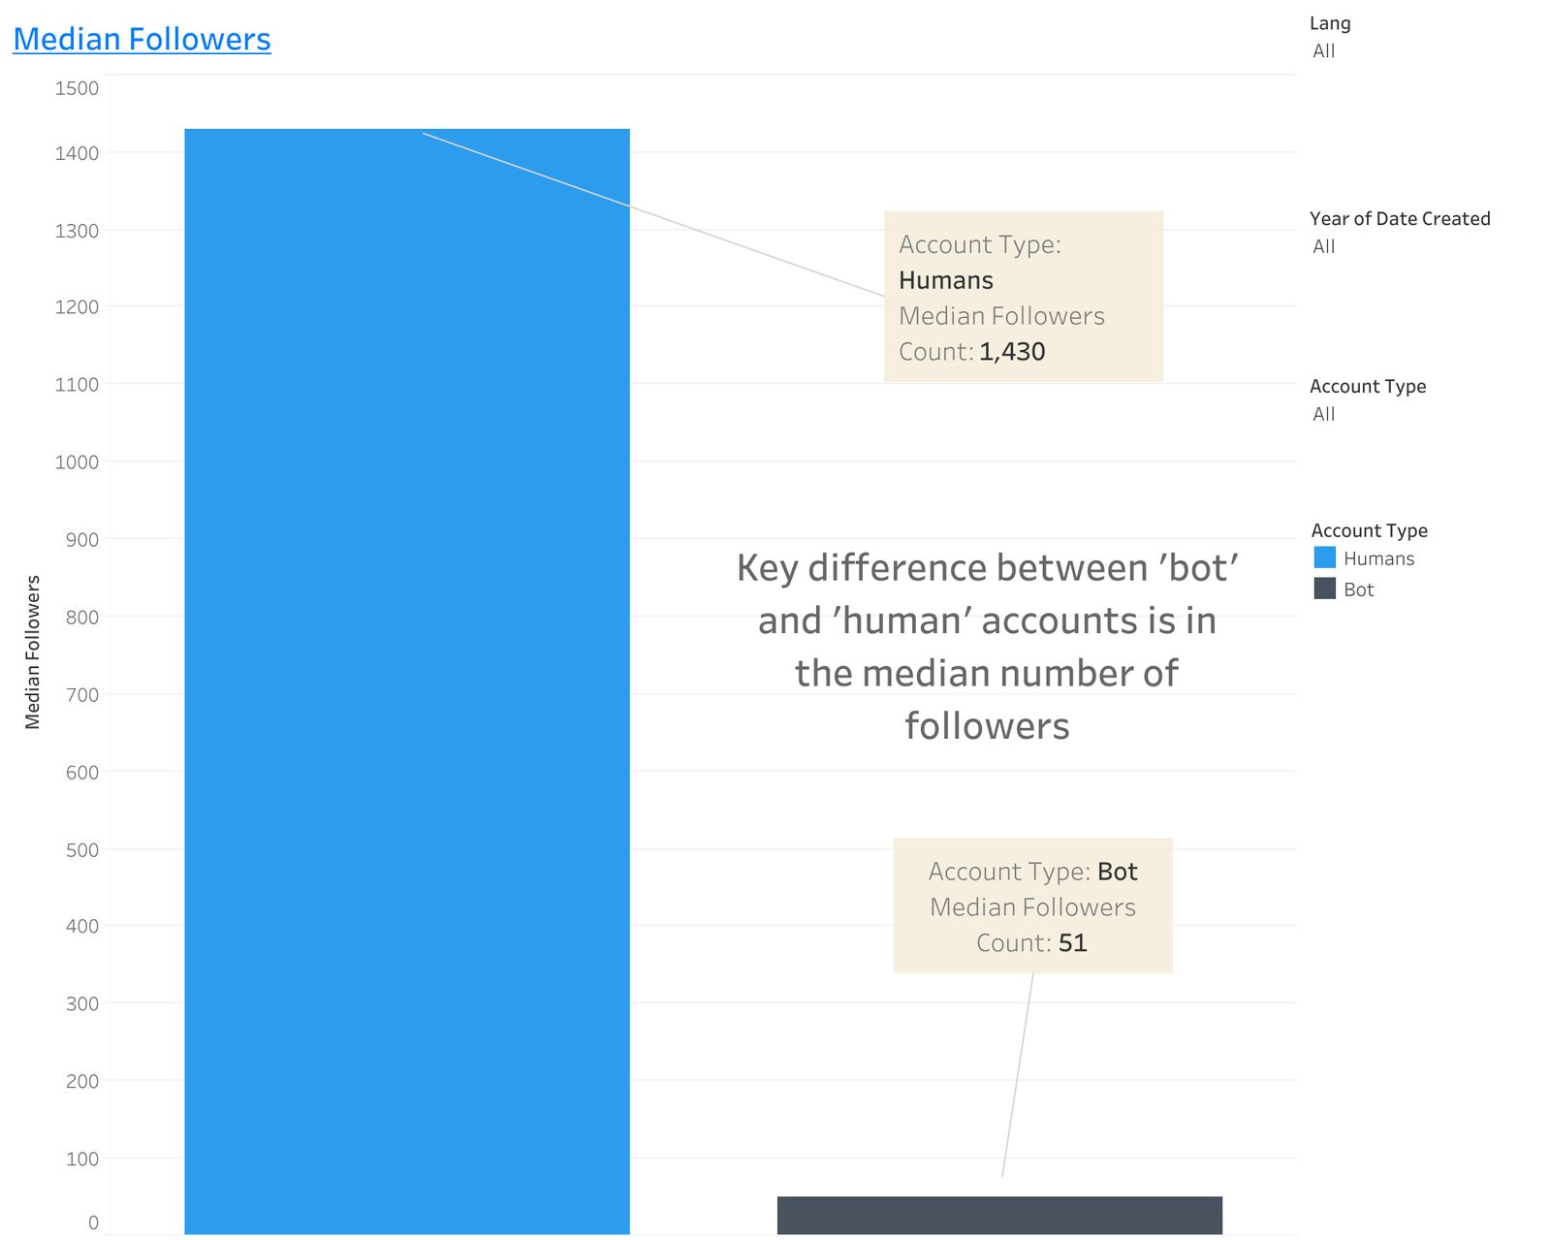
Median Followers

Slide 15
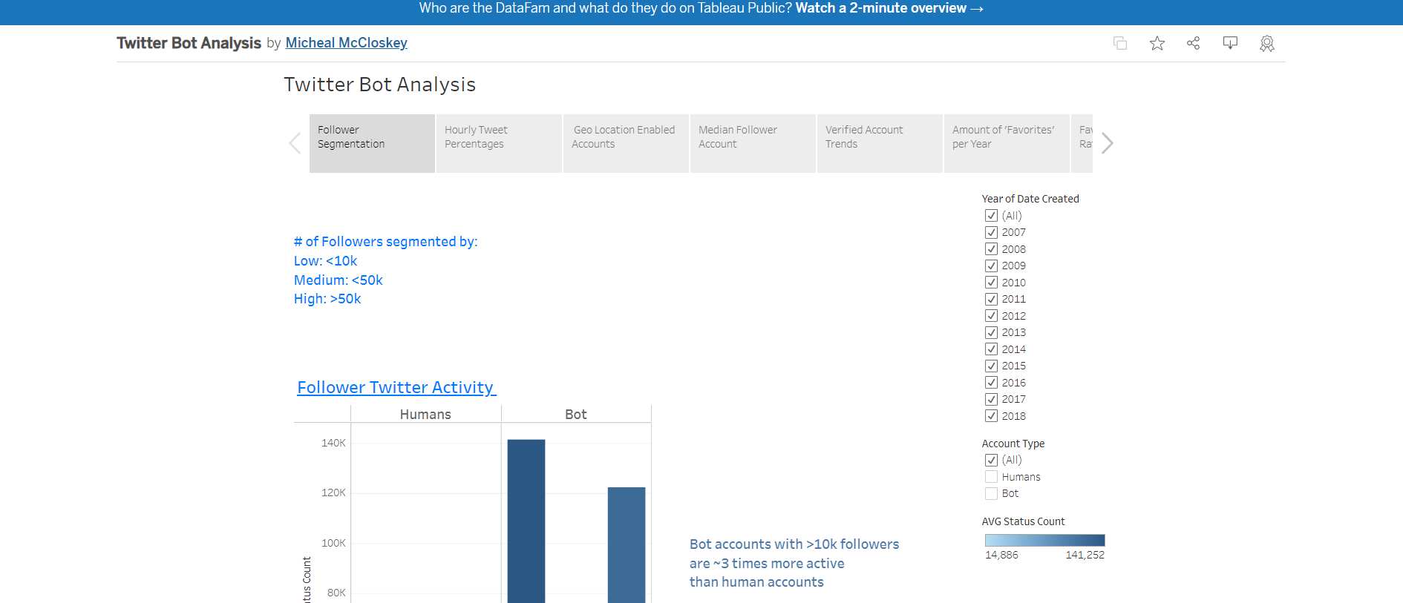
Interactive Dashboard

Slide 16
Conclusion
1
Analyzed thousands of Tweets
Developed Five Machine Learning Models
2
Random Forest Performed with 88% Accuracy
3
4
Identified Interesting Trends
Created an interactive Dashboard
5

